Slide 1
Application Level Encryption
Goals:
Screen survey responses from TLS decryption
Do not interfere with existing cybersecurity measures
Content filtering
Content analysis
Traffic analysis
Easy to implement and deploy

Slide 2
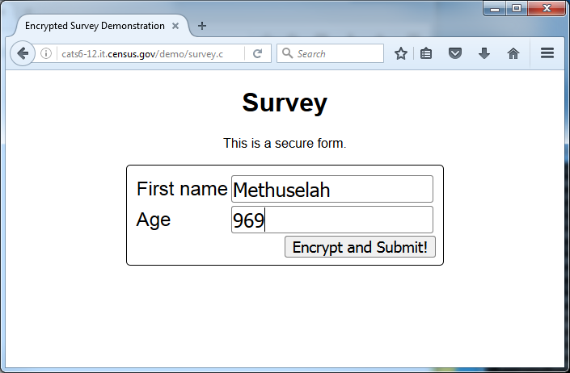
Example: A simple Survey

Slide 3



Example: A simple Survey
Web Crypto Keys
PUB
PRIV
HTML form
JavaScript
Public Key
PUB
Application-level Encryption performed by JavaScript and Web Cryptography API
Encrypted response

Slide 4


Example: A simple Survey
Web Crypto Keys
PUB
PRIV
HTTP (HTML, JavaScript, PUB, etc.) ➜
Encrypted TLS Tunnel
↩HTTP POST
PUB
PUB
PUB
PRIV
PRIV

Slide 5
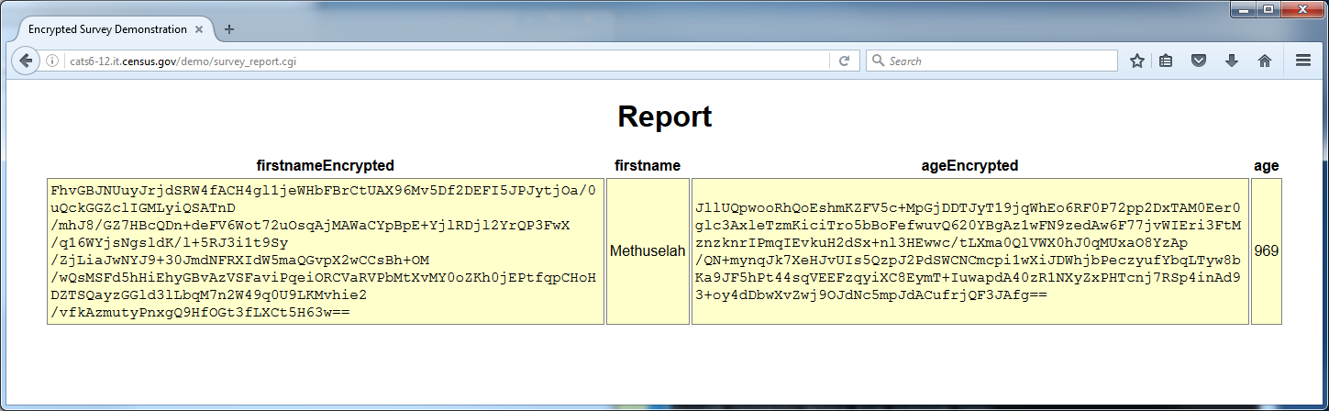
Field by field encryption concept.
Each field is encrypted with the public key using RSA OAEP (RSA with padding)

Slide 6
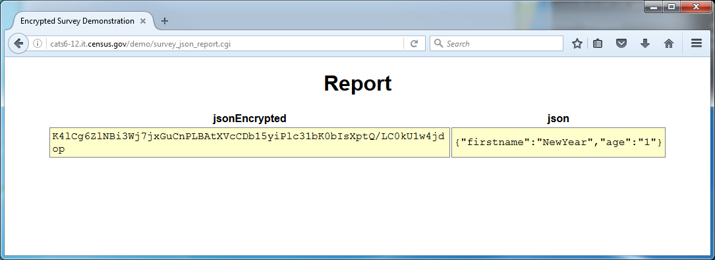
JSON Encryption Concept
Fields are packed into a JSON object.
JSON object encrypted with AES-256 session key.
AES session key is encrypted with RSA OAEP

Slide 7
Back-end decryption options
Option #1: Decrypt upon receipt
Server has private key in memory.
Middleware decrypts fields and provides decrypted fields to processing system.
Decrypted results stored in database.
Advantage: allows server-side validation, skip logic, etc.
Option #2: Bulk decryption
Encrypted results stored in database.
Batch process reads each encrypted value and decrypts, storing result in database (or elsewhere).
Advantage: additional server-side security.

Slide 8
Requirements
Server:
Python 3.6 implementation (could be written into Java)
RSA encryption library
Client:
JavaScript
Web Crypto API (W3C Recommendation 26 January 2017)

Slide 9
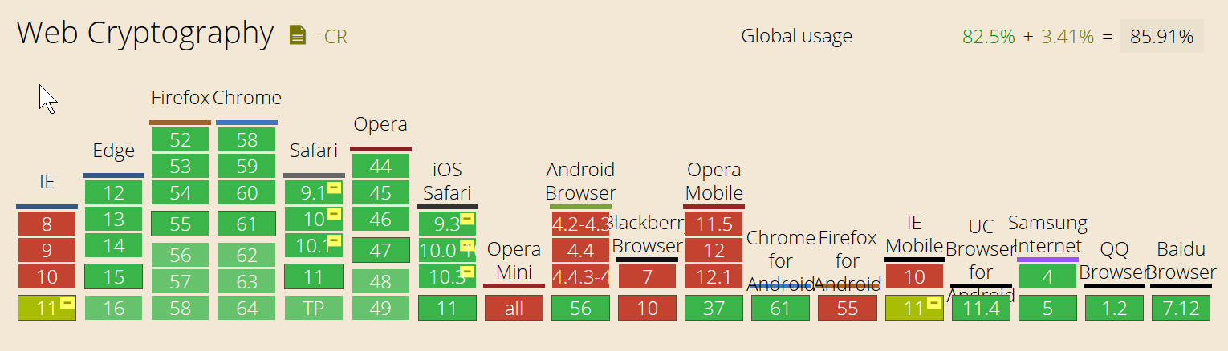
Support in browsers
Internet explorer can be supported with a JavaScript download

Slide 10
References
Microsoft Web Cryptography API
https://msdn.microsoft.com/en-us/library/dn265046(v=vs.85).aspx

